Slide 1
Introduction to Ions

Slide 2
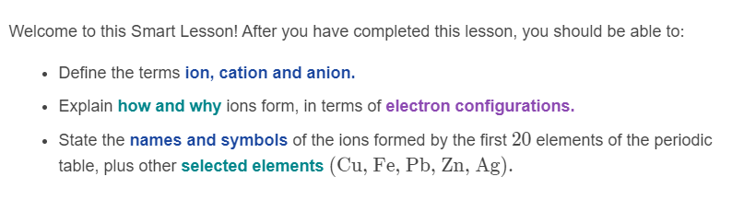
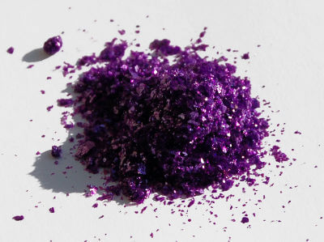

Slide 3

Ions are essential for life: if there were no ions, your body would not function! The cells in your body use ions to communicate.
Ions are also what make up crystals in the Earth's crust, and lightning in the atmosphere.

Slide 4
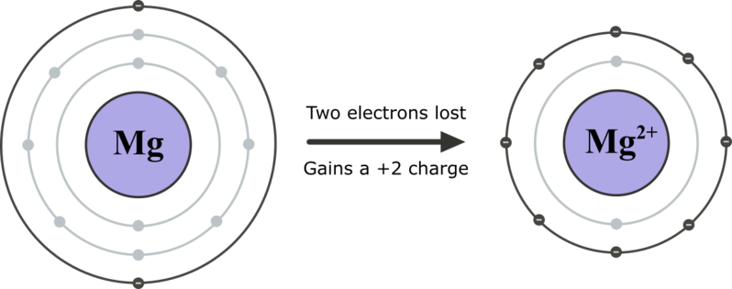
Ions are charged particles that form when an atom or molecule loses or gains electrons.
Atoms are most stable when their valence (outer) electron shell is full of electrons. Atoms without full valence shells can gain or lose electrons to become stable, and in the process they become ions.

Slide 5
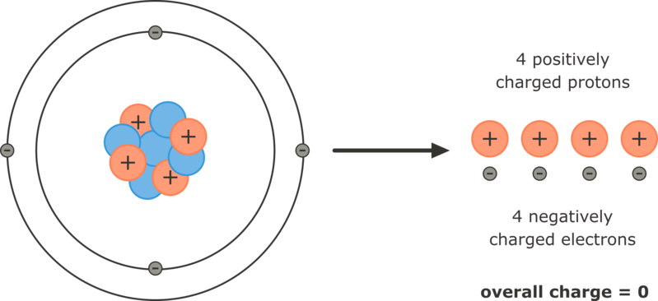
Atoms are electrically neutral particles because they have equal numbers of positively charged protons and negatively charged electrons.
The positive and negative charges cancel out so the atom has no overall charge.

Slide 6
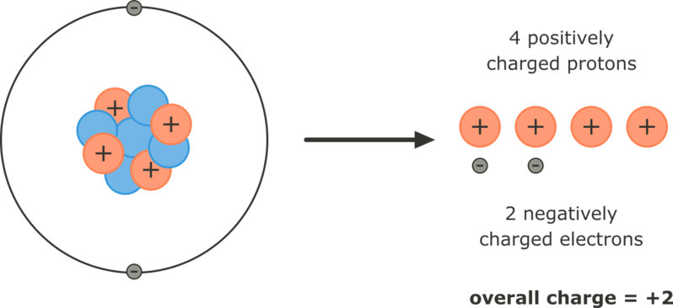
Ions are electrically charged particles because they no longer have equal numbers of positively charged protons and negatively charged electrons.
The positive and negative charges do not cancel out so the ion has an overall charge. This overall charge is either positive or negative depending on whether the atom loses or gains electrons.

Slide 7

Electrons are negatively charged.
If an atom gains electrons, it becomes a negatively charged ion.
If an atom loses electrons, it becomes a positively charged ion.

Slide 8
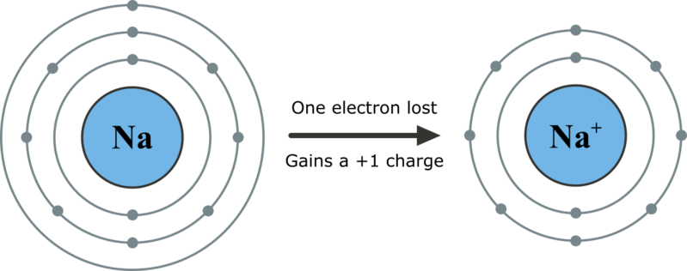
Atoms that have very few electrons in their outer shell, such as the metal atoms on the left-hand side of the periodic table, will lose electrons in order to achieve stability. This means their valence shell is emptied and only full electron shells remain.
The ion that is formed will have a positive charge equal to the number of electrons lost.

Slide 9

Positively charged ions are called cations.
An easy way to remember this is that cation has a t in it, which kind of looks like a + sign, hence the positive charge!

Slide 10
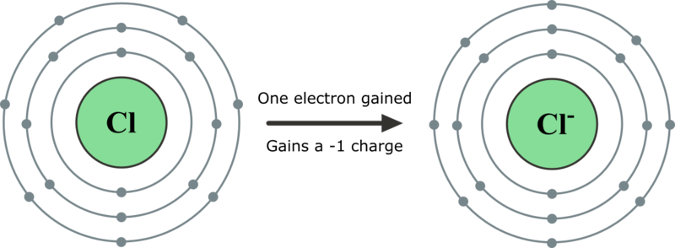
Atoms that have many electrons in their valence shell, such as the non-metal atoms on the right-hand side of the periodic table, will gain electrons in order to achieve stability. The valence shell will be filled.
The ion that is formed will have a negative charge equal to the number of electrons gained.

Slide 11

Negatively charged ions are called anions.
An easy way to remember this is that anion has an n in it and n is for negative!

Slide 12
How do we name different types of ions?
Cations have the same name as their parent atom, with "ion" added to the end.
For example, a sodium atom becomes a sodium ion.

Slide 13
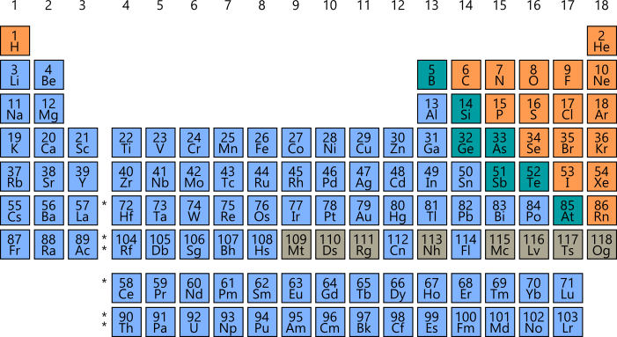
Metal atoms, found on the left-hand side and middle of the periodic table, form cations. Hydrogen also forms a cation although it is a non-metal.
If the element is found on the left-hand side of the periodic table, there's a good chance the name of the ion is the same as the name of the atom.

Slide 14
Anions have different names to their parent atom.
The end of the element's name is replaced with -ide. For example, a chlorine atom becomes a chloride ion.

Slide 15
Non-metal atoms, found on the right-hand side of the periodic table, form anions. These are shown in orange on the periodic table below.
Elements in group 15,16 and 17 will all form ions with different names to their parent atom.

Slide 16

When referring to an ion, you should always say ion after the name to avoid confusion. Don't just say sodium - say sodium ion!
This will let people know that you are talking about the charged ion and not the neutral atom, which will become very important as you learn more about chemical reactions.

Slide 17
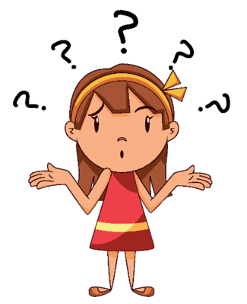
Some atoms can form more than one type of ion.
These are usually the transition metals from the middle of the periodic table. For example, an iron atom can lose either two or three electrons from its outer shell, forming the ions Fe²⁺ or Fe³⁺ respectively.
We can't just call these both "iron ion", so we need a way of distinguishing between the two.

Slide 18
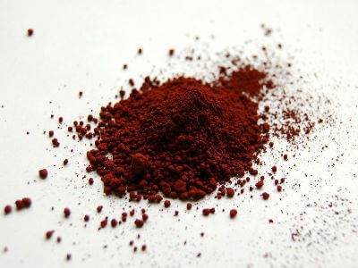
To distinguish between ions of the same element with different charges, we use Roman numerals.
Roman numerals are letters that represent numbers. For example, the letter I is used to represent 1, II represents 2, and III represents 3. Therefore, Fe²⁺ is called the iron(II) ion (read "iron two ion") and Fe³⁺ is called the iron(III) ion (read "iron three ion").
Important note: You must use a capital "i" to represent the number when typing on the computer. You cannot type a lowercase "L" or a "1" or any other symbol - these are wrong.

Slide 19
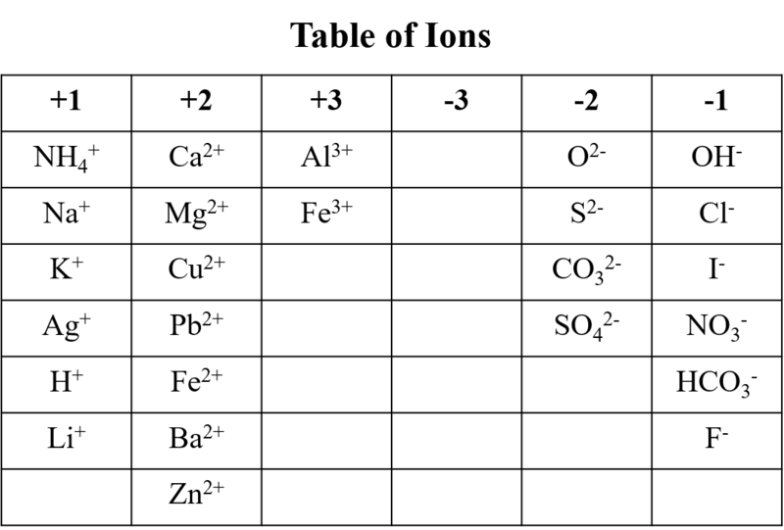
It will not have any of the names of the ions on it, only their symbols. You will need to remember the names of the given ions.

Slide 20


Slide 21
When writing the symbol for an ion, you must indicate its charge.
Remember, ions have a positive or negative charge equal to the number of electrons lost or gained by the atom.
Ion symbols are written by writing the chemical symbol of the element followed by the overall charge on the ion as a superscript (small number at the top). For example, calcium atoms lose two electrons to become ions with a charge of +2. The symbol for a calcium ion is written Ca²⁺.

Slide 22
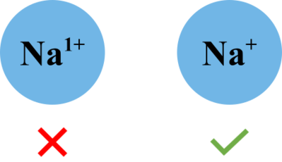
If the overall charge on an ion is either +1 or −1, do not write the 1. You simply need to write a + or − symbol. For example, the symbol for a sodium ion is Na+ and not Na¹⁺.

Slide 23
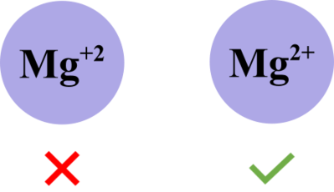
When an ion has a charge that is greater than 1, you must indicate the magnitude of the charge with a number. The number always goes before the charge when writing the ion symbol. For example, the symbol for a magnesium ion is Mg²⁺ and not Mg⁺².

